Slide 1

Integrating Ansible Automation and ChatOps
Hazel Shen
Solution Architect @Red Hat Taiwan
Notes:
Hi everyone, I am Hazel from Red Hat Taiwan, glad to see you at Hong Kong Open Source Conference 2021.
I will introduce Ansible briefly, which is a well-known automation tool all over the world.
And some scenarios about integration Ansible Playbooks with 3-rd party application like chatbot.
There are tons of topics covered by Automated integrations, but today I will just focus on ChatOps.

Slide 2




About Me
Hi I am Hazel Shen.
Solution Architect @Red Hat Taiwan
Find me by:
hazel910159@gmail.com
https://hazel.style/
https://github.com/hazel-shen
Notes:
First of all, I am a Solution Architect, in charging of Red Hat Application development solutions.
I am interested in SRE domain and Cloud Native related project.
you can find me by the following links, I will share Ideas, or issues I’ve dealt with on my blog.
And of course , the source code, including today’s topics, I have already push to my GitHub, you can fork, raise issues, or send PRs if you want.
If you have any questions, or ideas you want to discuss, welcome to mail me, or drop your message to chat room.

Slide 3
What is IT Automation
Automation Server
Virtual Machine
Provisioning
Installation
Confidential
Management
Network Configuration
Password
Token
Backup Configuration
Firewall Rules Management
OS
Dependencies
Create
Refresh
DevOPs
CI
CD
Approval
Ref: https://www.redhat.com/en/topics/automation/whats-it-automation
Notes:
Everyone has his own interpretation of IT Automation.
The following table shows many tasks that engineers may need to handle.
Just Imaging dealing with these tasks manually everyday drives me crazy, not to mention we will combine many different tasks in practical, right?
So, how can we make our jobs efficiently?

Slide 4
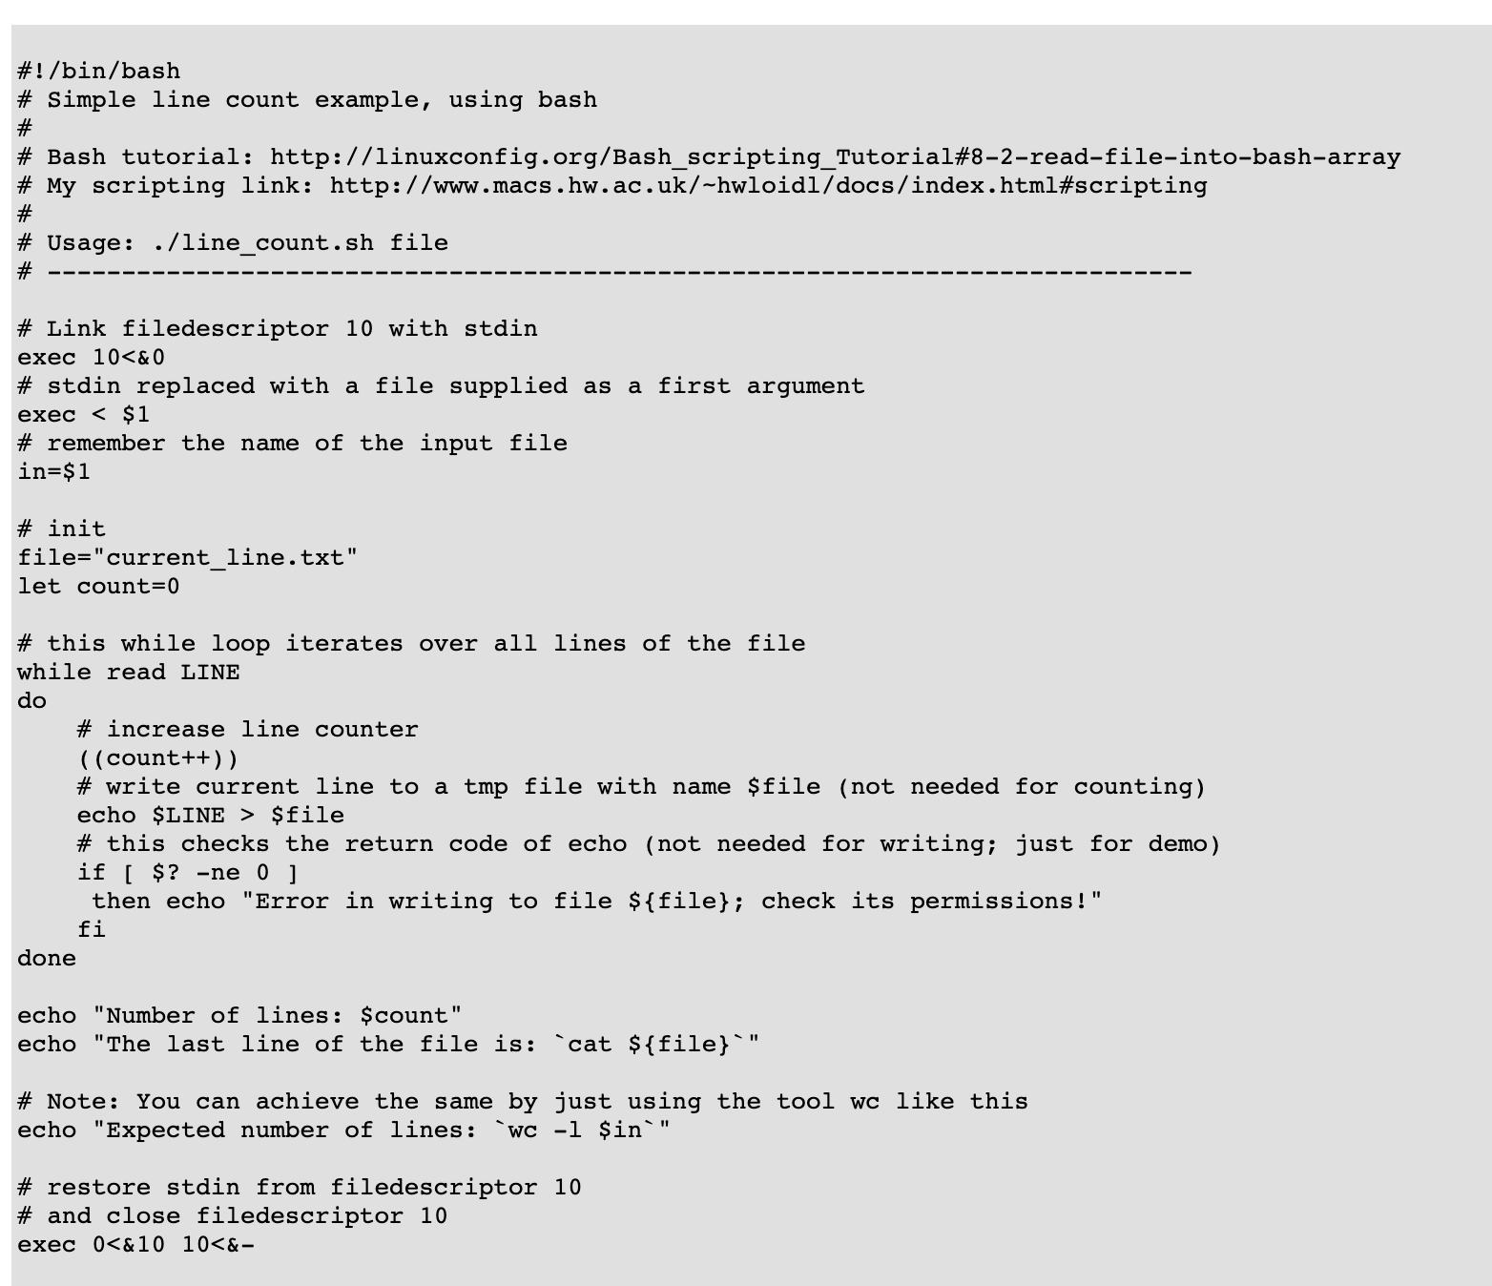
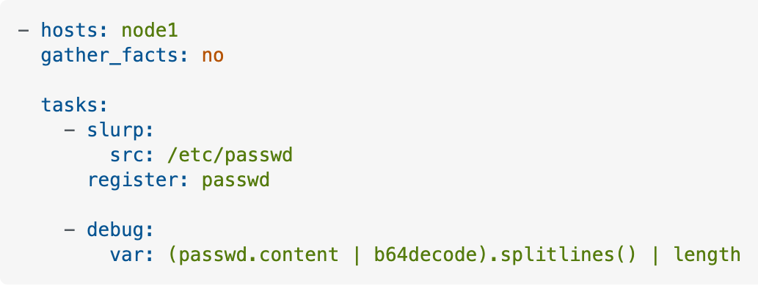
Shell Script vs Ansible Playbook
VS
Ref: http://www.macs.hw.ac.uk/~hwloidl/Courses/LinuxIntro/x864.html
Notes:
Shell Script is still a common approach to automate these tasks.
Not every IT Team has enough people to consider maintenance and reusage issues.
To be frank, shell script is a fast and convenient way.
But If the IT Team start scaling up, when the new member joining. The code readability might be an issue.
The top-to-bottom style make ansible playbooks clearly deliver what it will done in every tasks. And modules also save code lines abd your time.

Slide 5
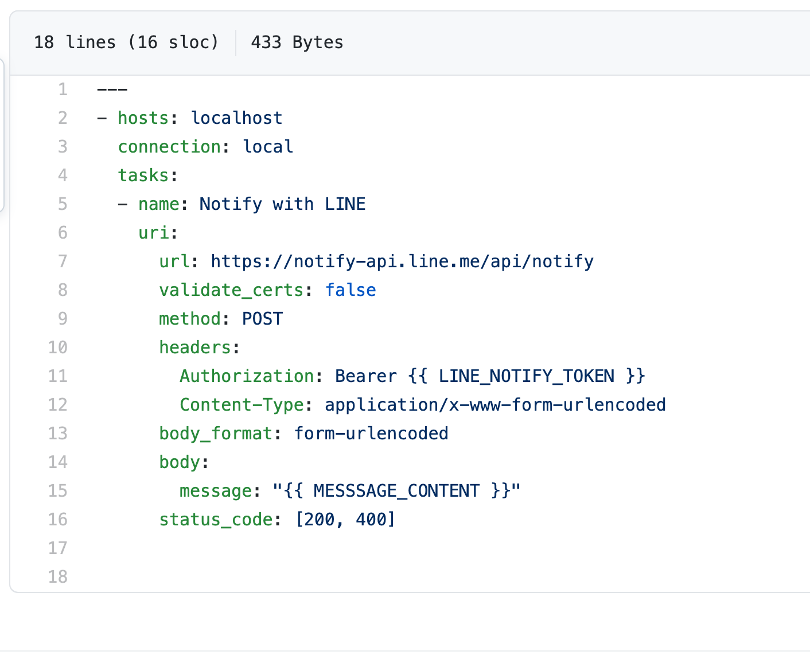
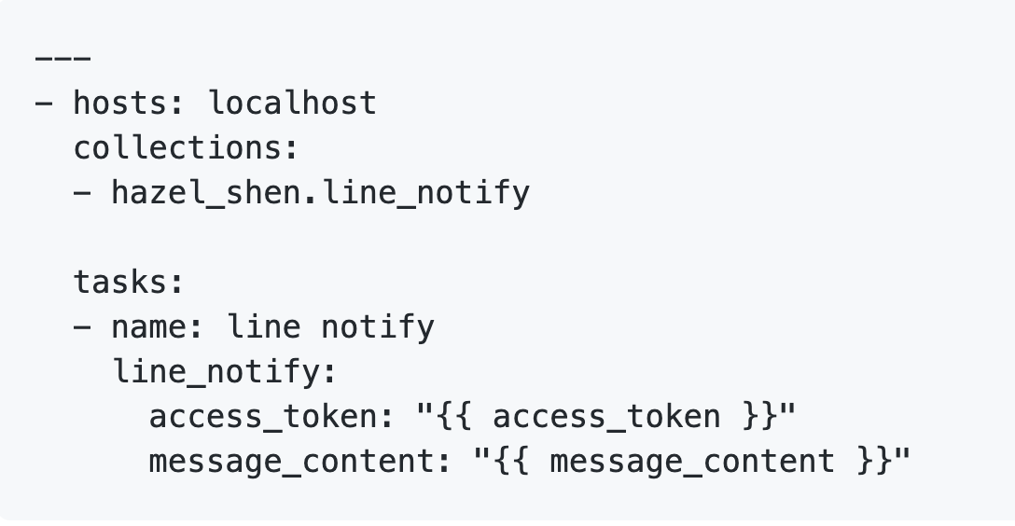
VS
Modules – Easier! Much Easier!
Ref: https://github.com/hazel-shen/LINE_notify_collection
Notes:
Besides solving issues, as a programmer, we pursue the ultimate simple. I will explain the reason why I wrote this playbook later.
It happened when I finished a curl playbook, an idea came to my head suddenly at that time.
I know it sounds ridiculous.
A voice told me “Why don’t you google something for shorten your playbook?”

Slide 6
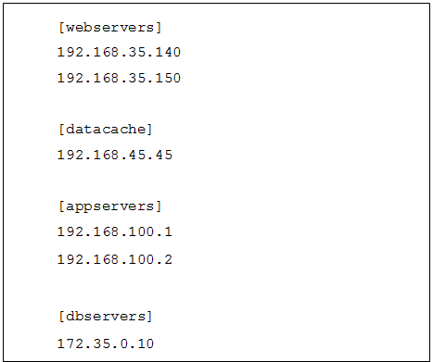
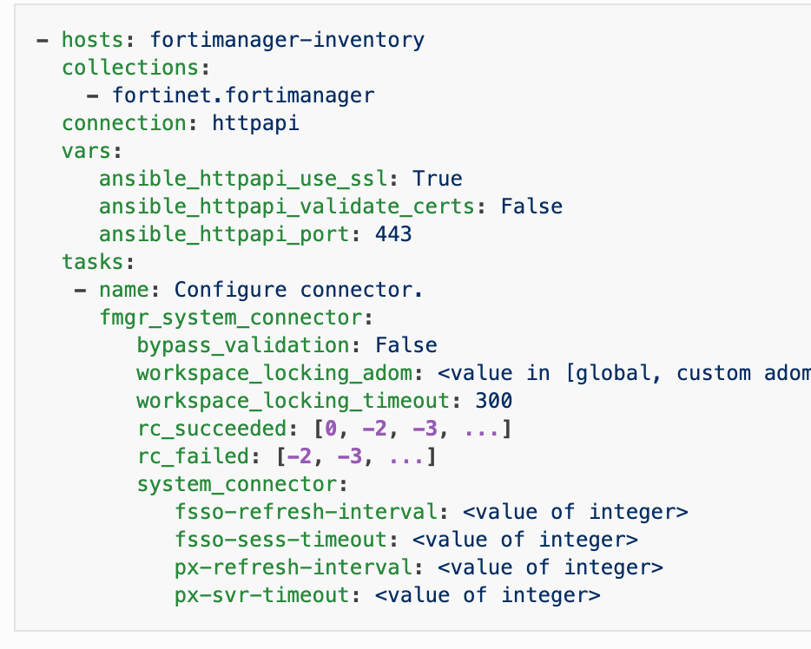






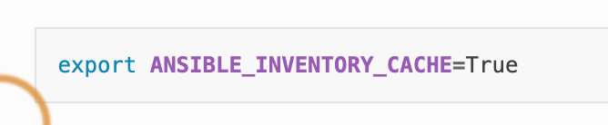
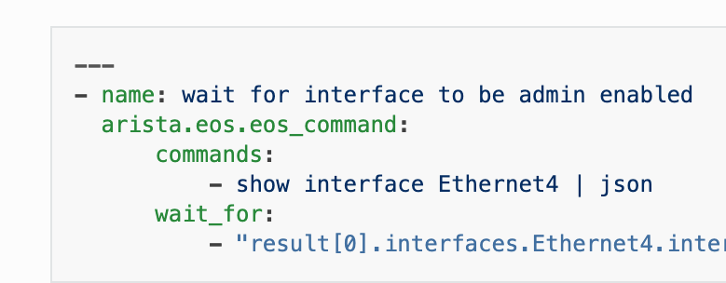



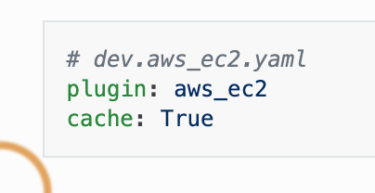

Ansible for Beginners
Ad-hoc
Private / Public
Clouds
Inventory
List
API & Connector
User
Playbbok
Modules
Plugins
Storages/
Databases
Command &Scripts
Ansible Components
Controlling Nodes
Target Nodes
Notes:
I have to go through this picture, or some of beginners might be dizzy about those Ansible terminologies
This is Ansible execution architecture from my perspective.
First, there are 2 roles, one is controlling node, all of the ansible tools will be installed on this node, and the other one is target node.
We can separate these components on controlling node in 2 parts, too.
Ansible playbooks are composited by Ansible components, they are inventory list, modules, API connectors, and plugins.
Inventory List list all of the target nodes the playbooks we use will do something to.
Modules are like a set of tools, and just for one target.
Connectors are like a command with a package of modules, if you wan to connect with an API needs some parameters, and parameters of parameters, you will need connectors.
Plugins are kind of like environment variables. If you turn that setting on, the playbooks will work that way.

Slide 7
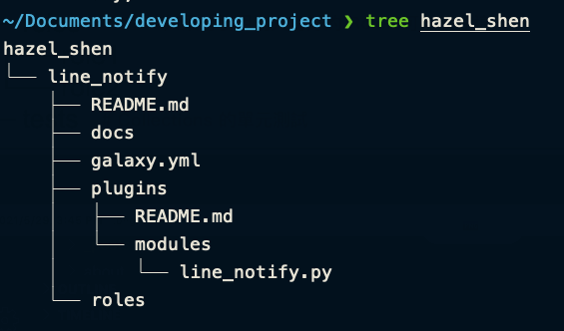
Contribute to Galaxy – Step 1
ansible-galaxy collection init ${my_namespace}.${my_collection}
Naming Principles
Namespace:
What the collection related to ?
Collection:
How the collection works ?
Ref: https://hazel.style/2021/05/28/How-to-contribute-your-first-Ansible-Collection-and-Ansible-Tower-Workflow-Use-Case/#more
Notes:
After googling for a while, I was sure there wasn’t any module could solve my problem.
So, I turned to studying how to package my own modules.
Ansible collections can be dived into 2 categories, the common one is module, and the other one is role.
We can use `ansible-galaxy` command to initialize the project.
Naming problem is the first thing we have to notice.
Collection’s name composed by namespace and collection, namespace may be related to organization or product series.
And collection name represents the collections’ functionality.

Slide 8
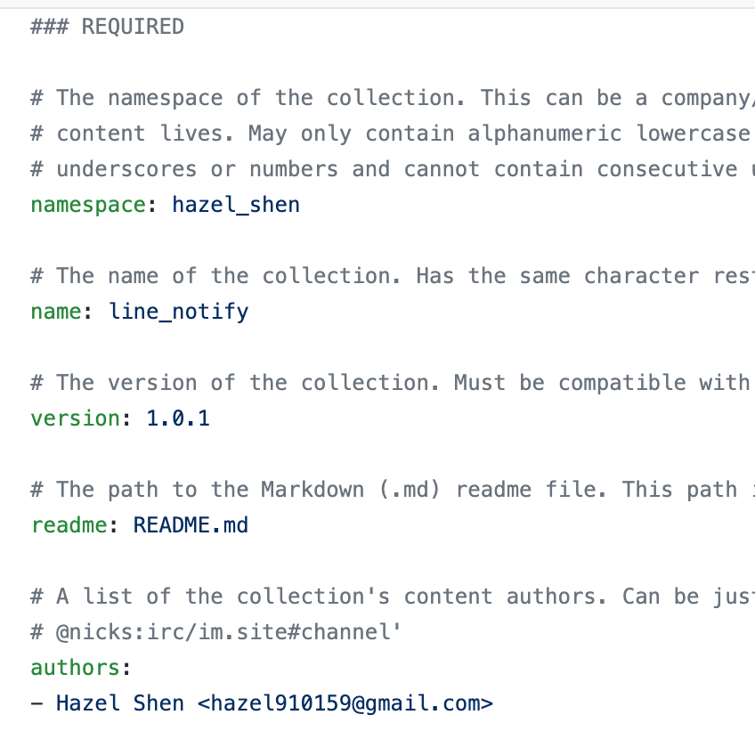
Contribute to Galaxy – Step 2
Ref: https://hazel.style/2021/05/28/How-to-contribute-your-first-Ansible-Collection-and-Ansible-Tower-Workflow-Use-Case/#more
Notes:
This is galaxy.yml
We should write about the collection’s author and information; the version number should be matched to the compressed file name.

Slide 9
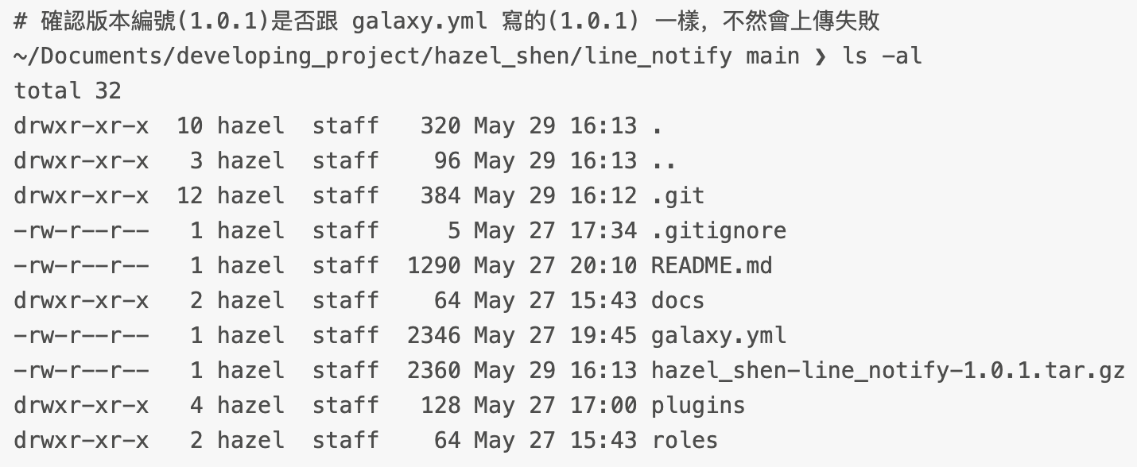
Contribute to Galaxy – Step 3
Ref: https://hazel.style/2021/05/28/How-to-contribute-your-first-Ansible-Collection-and-Ansible-Tower-Workflow-Use-Case/#more
Notes:
And then tar the file after programming works. As I mentioned, the version number should correspond to version in galaxy.yaml.

Slide 10
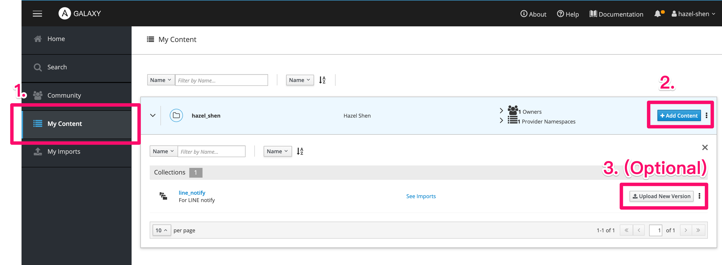
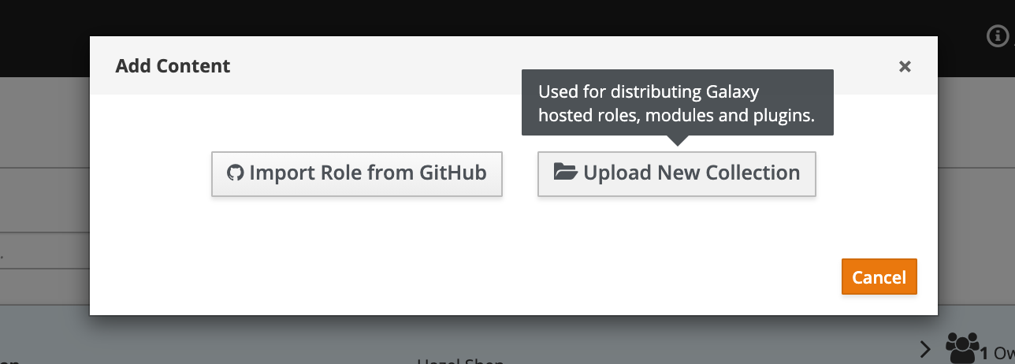
Contribute to Galaxy – Step 4
Ref: https://hazel.style/2021/05/28/How-to-contribute-your-first-Ansible-Collection-and-Ansible-Tower-Workflow-Use-Case/#more
Notes:
Finally, upload the tar file.
There’s another choice is importing from GitHub, but this is only for roles. If there’s nothing inside roles folder, the system will reject your uploading request.

Slide 11
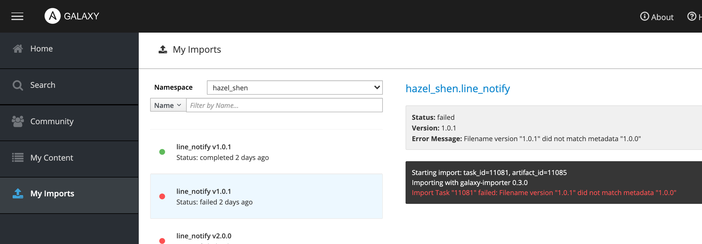
Contribute to Galaxy – Step 5
Ref: https://hazel.style/2021/05/28/How-to-contribute-your-first-Ansible-Collection-and-Ansible-Tower-Workflow-Use-Case/#more
Notes:
It’s done!
Now we can share the self-made module to the other programmers!

Slide 12

Use Case : with LINE Notification
Ref: https://youtu.be/ShWHYeIk40U
Notes:
Let’s see the first demo
This is a workflow playbook for provision Windows Server on Azure.
There are 3 playbooks in one process, if the playbook succeed, the flow will go through the green lines, otherwise it will fall to the red line.
And I put LINE Notification playbook In every red line.
Indeed, the binary classification can help us reduce the conditional expressions code effort.

Slide 13

The Idea came from …?
Notes:
However, the Chat notification is closer to our daily life, almost everyone has a smart phone installed messaging apps.
In Taiwan, about 90% people use LINE for not only personal use, but also official communication.
In case we don’t take laptop with us, we can still do something with messaging apps.
The Chatbot and mobile payment are two of the chat applications.

Slide 14
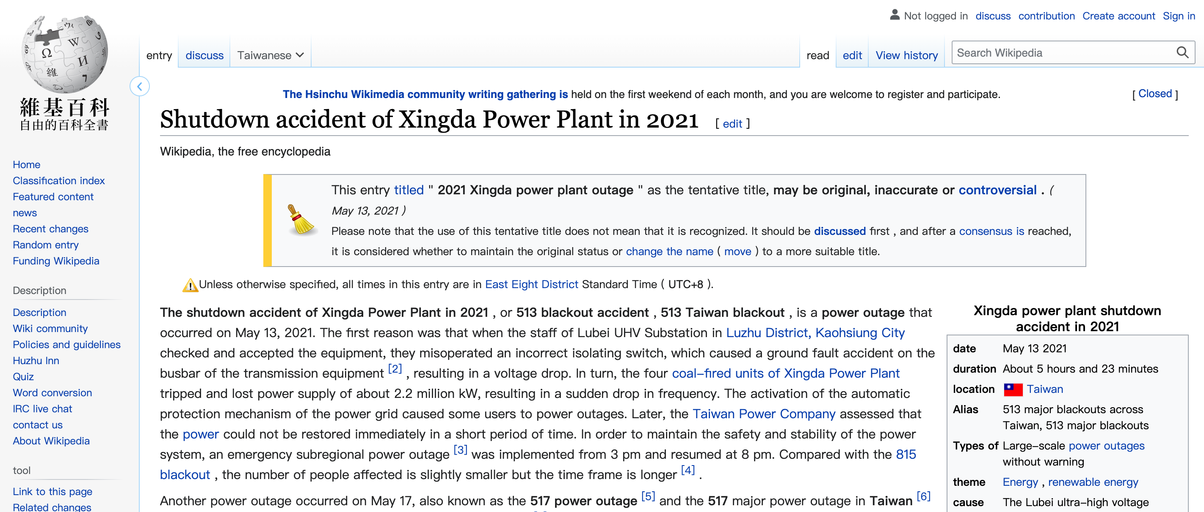
Power Outage in 5/13, 5/17
Notes:
And another reason I wanted to show this demo case is 2 power failure emergencies this year in Taiwan.

Slide 15



What about my data?
I haven’t backed them up !
I was still on my way home
Ref: Copyright © 2011 Twentieth Century Fox Film Corporation. All rights reserved.
Notes:
Well, before power failure happened, I received such a cell broadcast message.
If you are aware of the time on the first line in first message, you will see the incident time in first message was at 14 o’clock and 37.
And power supply would stop at fifteen o’clock. It was too rush for me to start back-up and restore process.
I didn’t bring my laptop with me @ that time.
All things in my head were oh my data
I haven’t back up my Ansbile Tower, I had to demo to my customers tomorrow!
I felt like I am one of the character in the movie - In Time.
Of course, the rebuild process is easy for Ansible Tower, but what if the scenarios are more complicated?

Slide 16
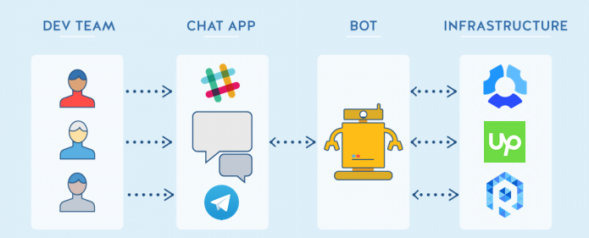
What is ChatOps
Notes:
Therefore, I start googling if there were use cases for integrating automation with chatbot.
Then I found some blog posts describing ChatOps.
ChatOps was derived from 2016, and it was advocated around 2019 with Chat Apps providers.
Much more use cases were been mentioned with DevOps.
10 mins ago I have mention about IT automation.
In fact, the degree of IT automation depends on how familiar with your equipment.
But DevOps implicates for everyone aspect of the company, and how people design the process.
The ChatOps point is rules of Chatbot, which is just like rule engines.
how to design chatbot depends on process in IT Teams, and the final purpose is controlling process accurately by command.

Slide 17
Chatbot Flows I – Active Trigger
Session
Start
Return
Result
Return
Message
command
Rule
pattern
Trigger
Backend
service
Rule
Pattern
Chatbot
Chatbot
Notes:
LINE Notification is the simplest way to implement ChatOps.
You don’t even need to create a bot, just need to call the LINE Notification API.
But If you want to build a real chatOps flow, know the types of chatbot application may be a better way.
How to Interact with chatbot?
There are 2 senarios, Active Trigger and Passive Reception.
The Active Trigger will be start from a command, after processing by series of patterns,
and then trigger backend services, call the 3rd parties’s API, or return directly.

Slide 18



ChatOps Flows II – Passive Reception
Do
something
Rule
Pattern
Return
Message
Webhook
Server
command
Send
Bot
Message
Session
Start
Return
Message
Rule
Pattern
Backend
Service
Rule
Pattern
Trigger
Return
Result
Chatbot
Chatbot
Notes:
Passive Reception is partially different from active trigger.
you may want to add some webhooks, like GitHub Webhook, Jenkins Webhooks, IT services management.
In Most of cases, when these Webhooks were triggered,
the webhook server will call the chatbot API and then send bot message or trigger another tasks.
Somebody may be curious about how many types of Chatbot. It depends on Chat Apps Provider,
Look at the end of the flow, which is “Return Message”
The types of messages are designed by chat apps providers.

Slide 19
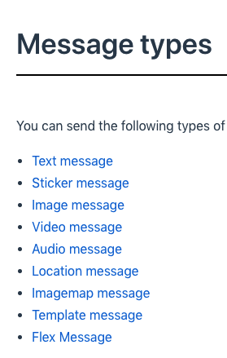
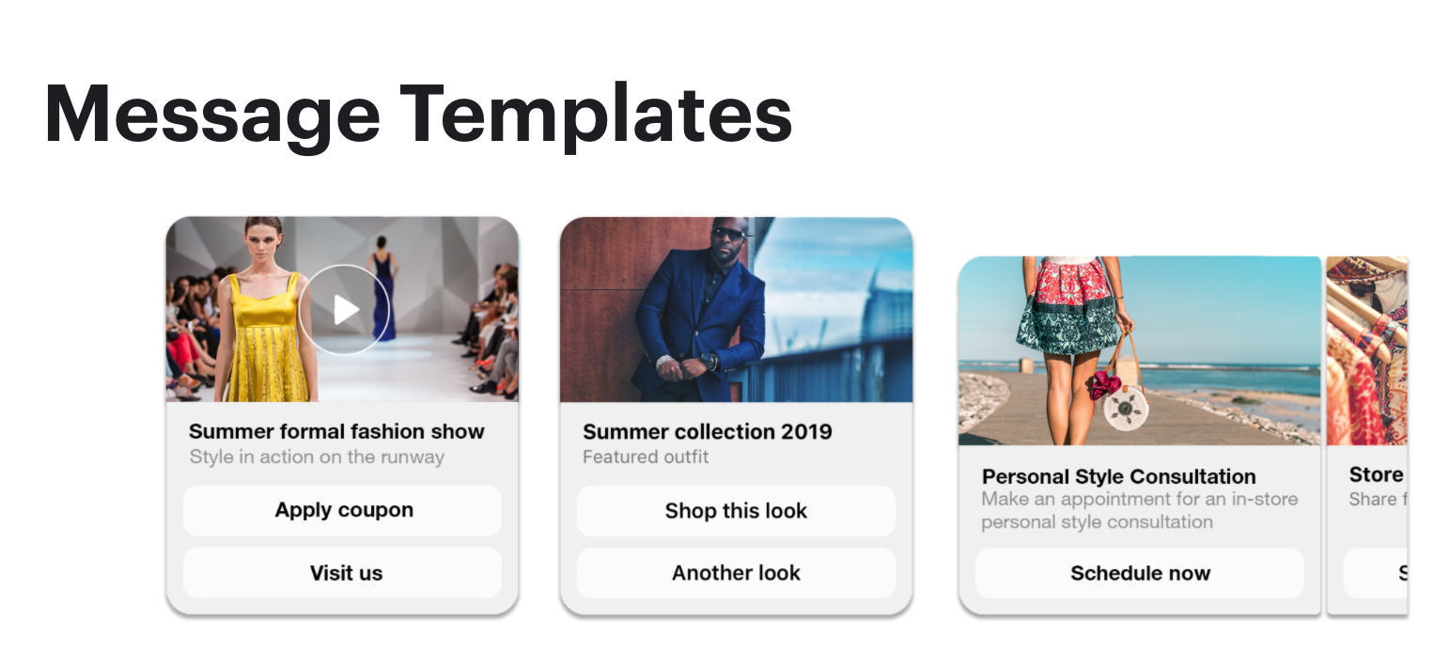
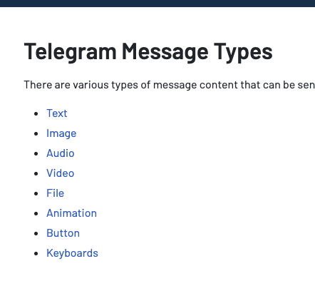
Chat Bot Message Type
LINE
Telegram
FB Messenger
Ref:
https://developers.line.biz/en/docs/messaging-api/message-types/
https://doc.stella.sanuker.com/docs/en/tg-message-types/
https://developers.facebook.com/docs/messenger-platform/send-messages/templates/
Notes:
The followings are message types from different providers.
Some ChatApps Providers allow user to layout the message templates by JSON object.
There are many examples.
some developers collect audio messages and process them by speech recognition for translating application.

Slide 20
Sounds good, but what if…
Security
Privacy
Policy
..
Notes:
The picture of ChatOps looks perfect, we can handle everything without laptop!
In practice the factors we need to consider are far beyond imagination.
The data security, how to encrypt the confidential information like password.
Privacy issue like I don’t want any 3-rd party application gets my phone number.
Last reason might be policy, Lost my job due to violating management policies sounds not interesting.

Slide 21

What is
The open source communication platform which is similar to Slack.
Support self-managed server installation and container platform
Support video, audio and screen sharing (Technical supported by WebRTC)
Provide iOS/Android Apps
Ref: https://softnshare.com/rocket-chat-%E9%96%8B%E6%BA%90%E7%9A%84%E5%9C%98%E9%9A%8A%E5%8D%B3%E6%99%82%E9%80%9A%E8%A8%8A%E7%B3%BB%E7%B5%B1/
Notes:
Today I want to introduce an open source and fully free communication platform which is Rocket Chat.
The user experience is just like Slack, so users don’t need to get used to the interface again.
The most important reason is we can install the chat server on our own environment.
If you have lots of troubles with online chat apps, Rocket Chat is nice choice you may want to consider.
Also, it provide iOS and Android support.

Slide 22
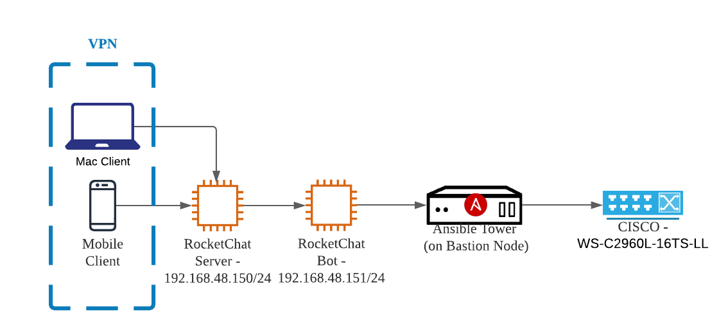

My Environment
Notes:
I am going to demo the chat flow from my iPhone to chat server by VPN. This is a brief architecture for the following demo case.
The Rocket Chat Server and Chat bot were separately installed on two virtual machines with RHEL, and the Ansible Tower was installed on my bastion node.
The CISCO Switch there is for collecting its version by Ansible Playbook.
And the client connect to Chat Bot Server by VPN.

Slide 23
Use Case II: ChatOps with Ansible
Ref: https://youtu.be/h7_SsYHu90g
Notes:
Let’s check the second use case. You can also installed the Rocket chat and the Ansible Tower in containerized way.
After I input the command “CISCO”, the playbooks for getting CISCO version will execute and return the finish time.

Slide 24
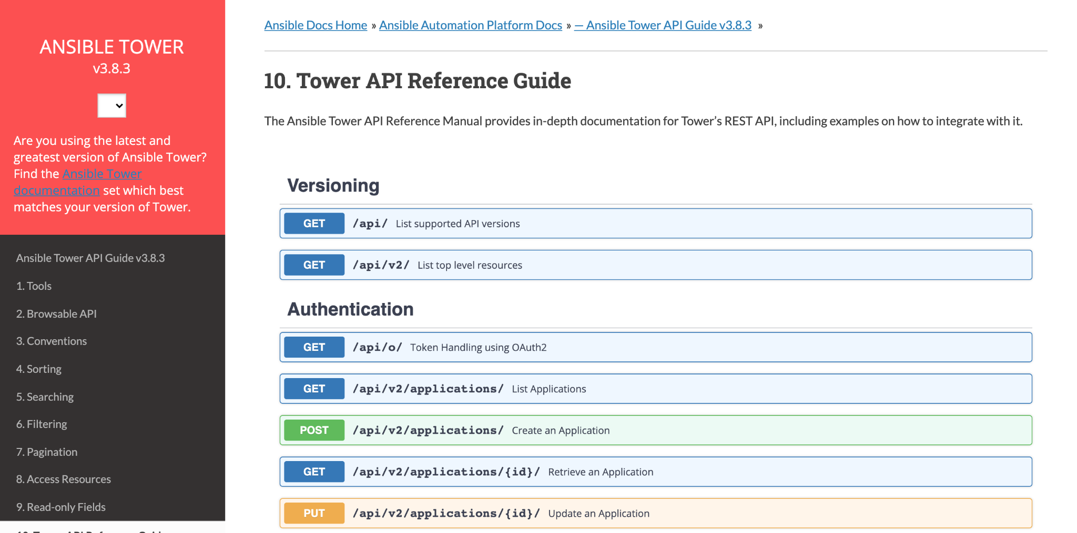
Integrate with API
Ref: https://docs.ansible.com/ansible-tower/latest/html/towerapi/api_ref.html
Notes:
You can directly trigger Ansible playbooks by command, if you just want to do some simple works like execute playbooks, Ansible is enough.
But if you want to gather logs, control permissions or somehting like resources allocation. You might need Ansible Tower handling these tasks for you.
Ansible Tower is a centralized center for managing your Ansible Playbooks, and there are well-ready APIs for users to getting information.

Slide 25
What‘s More?
Notes:
ChatOps is a collaboration model that connects people, tools, process, and automation into a transparent workflow in your team.
You can put CI/CD process on the chatbot, use command to push ready code to the GitHub. Before deployments starting, you can even use Chatbot approve or reject the merge requests.

Slide 26
Q&A Time!
Notes:
Thanks for your time, and we have five minutes for questions and answers.
if you have questions, or any ideas want to share, please leave it in the chatroom.
I will check it one by one.

